Slide 1
Barbell Portfolio
Mykyta Medvediev, 2022

Slide 2
Table of contents
Recap
Regression analysis
Monte Carlo simulations
Conclusions

Slide 3
Recap

Slide 4
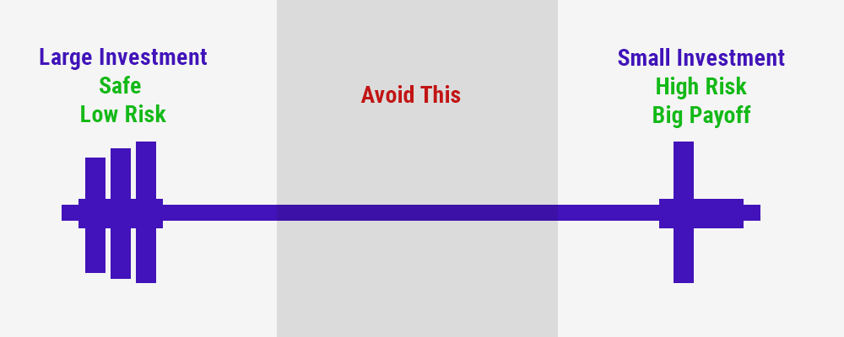
Recap: Background

Slide 5
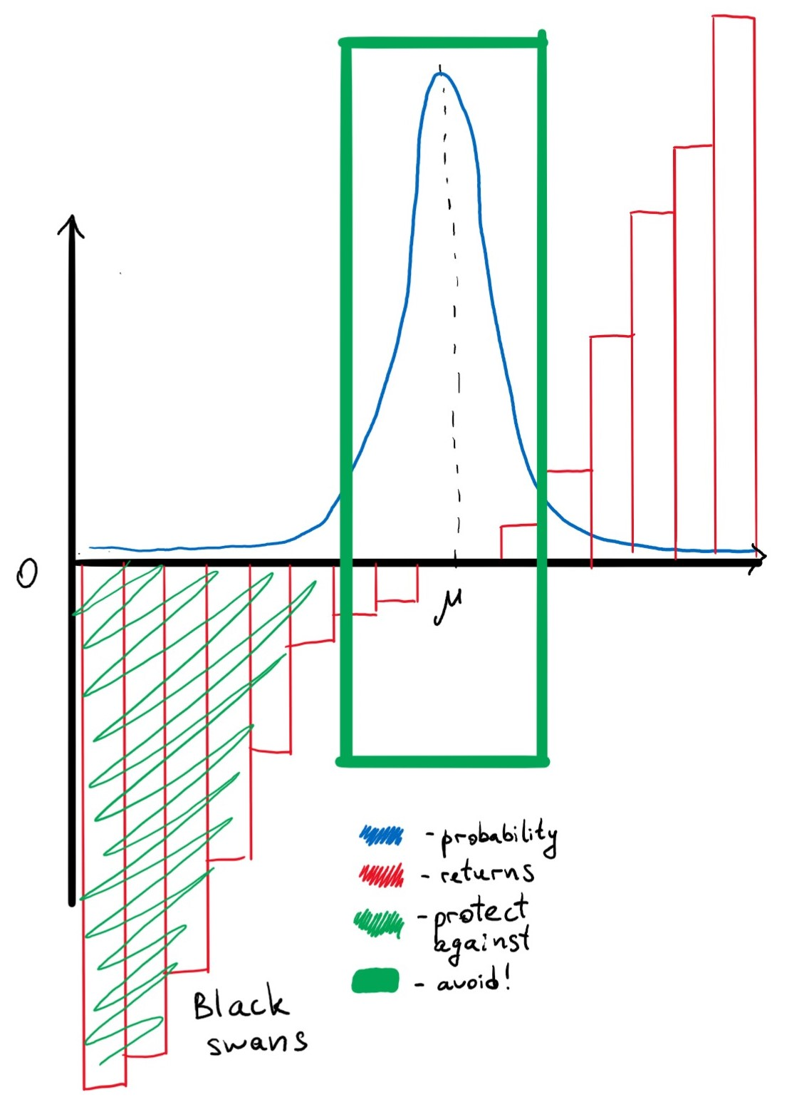
Recap: Background
What portfolio does

Slide 6
Recap: Asset allocation
Side | Ticker | Start date | % Weight | Side | Ticker | Start date | % Weight
Left side |  |  | 85% | Right side |  |  | 15%
TIPS | TIP | 2004 | 40% | Emerging Market ETFs | EMSH | 2014 | 10%
 | LTPZ | 2010 | 10% |  | EEM | 2004 | 10%
Short duration bond etfs | SHV | 2007 | 4.29% |  | VWOB | 2014 | 10%
 | VGSH | 2010 | 4.29% | High Yield Bonds | SPHY | 2013 | 10%
 | VCSH | 2010 | 4.29% |  | BSJO | 2017 | 10%
 | SHM | 2008 | 4.29% |  | HYG | 2008 | 10%
 | BSV | 2008 | 4.29% | Meme stocks | AMC | 2014 | 10%
 | BIL | 2007 | 4.29% |  | GME | 2003 | 10%
 | BWZ | 2009 | 4.29% | Crypto | GBTC | 2015 | 10%
Gold | GC=F | 2001 | 20% |  | ETHE | 2019 | 10%
Left side: paranoically safe
Right side: stupid risky
[A note about startups]

Slide 7
Recap: Calculations
Left side:
Mean = 4.62
Std = 7.38
Kurt = 27.20
Skew = -0.113
Overall Portfolio:
Mean = 9.28
Std = 13.39
Kurt = 0.3
Skew = 39.02
Right side:
Mean = 51.19
Std = 67.25
Kurt = 145.39
Skew = 3.97

Slide 8
Recap: Hypothesis testing
Quick note:
Left side has 3017 degrees of freedom and starts from 2008, while the right side only has 643 and starts in 2019.
This is a limitation of trying to calculate cryptocurrency statistics, Ethereum specifically.
Because of that, the portfolio DataFrame will only have 643 degrees of freedom as well.

Slide 9
Recap: Hypothesis testing
Is the left side’s mean return equal to 0?
Is the right side’s return equal to 0.009?
Are variances of both sides of the portfolio equal?
Is the left side’s variance equal to 0?
Is the right side’s variance equal to 1.198?
Are mean returns from both sides of the portfolio equal?
Is there a correlation between the sides?

Slide 10
2. Regression Analysis

Slide 11
Regression analysis
Individual securities vs market
Left side vs market
Gold vs market
Left side vs right side
Overall portfolio vs market

Slide 12
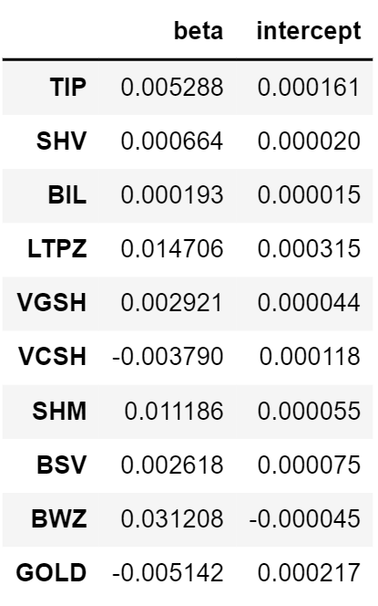
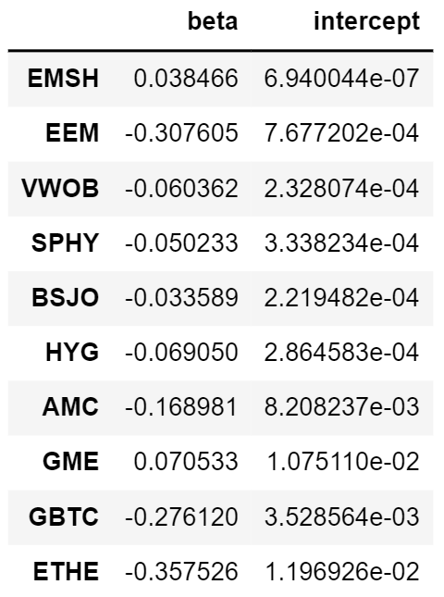
Regression analysis
Individual securities vs market

Slide 13
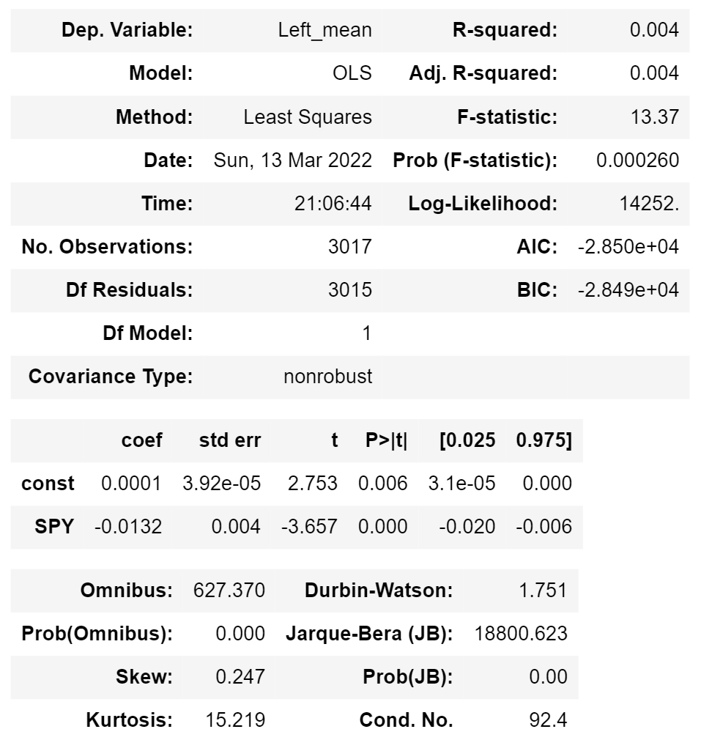
Regression analysis
2. Left side vs market

Slide 14
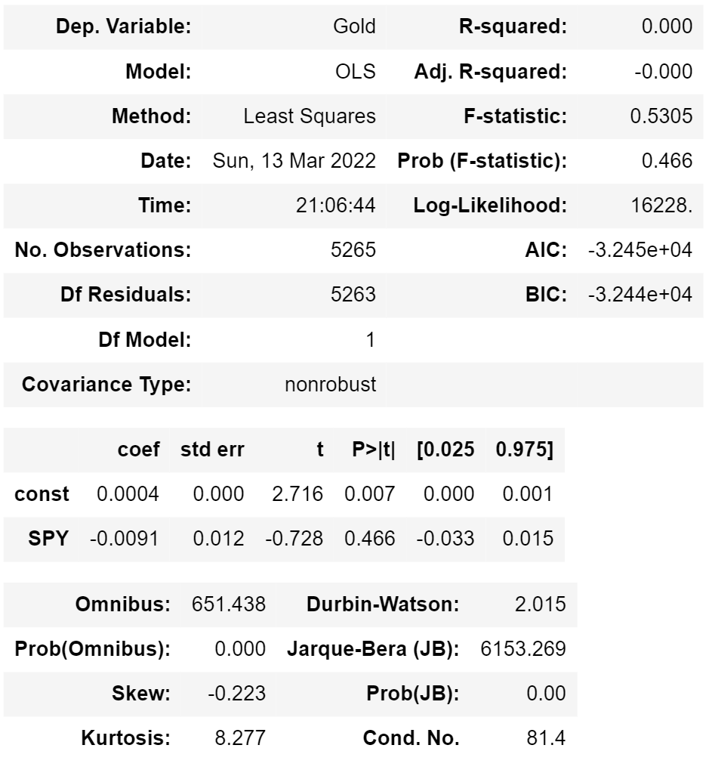
Regression analysis
3. Gold vs market

Slide 15
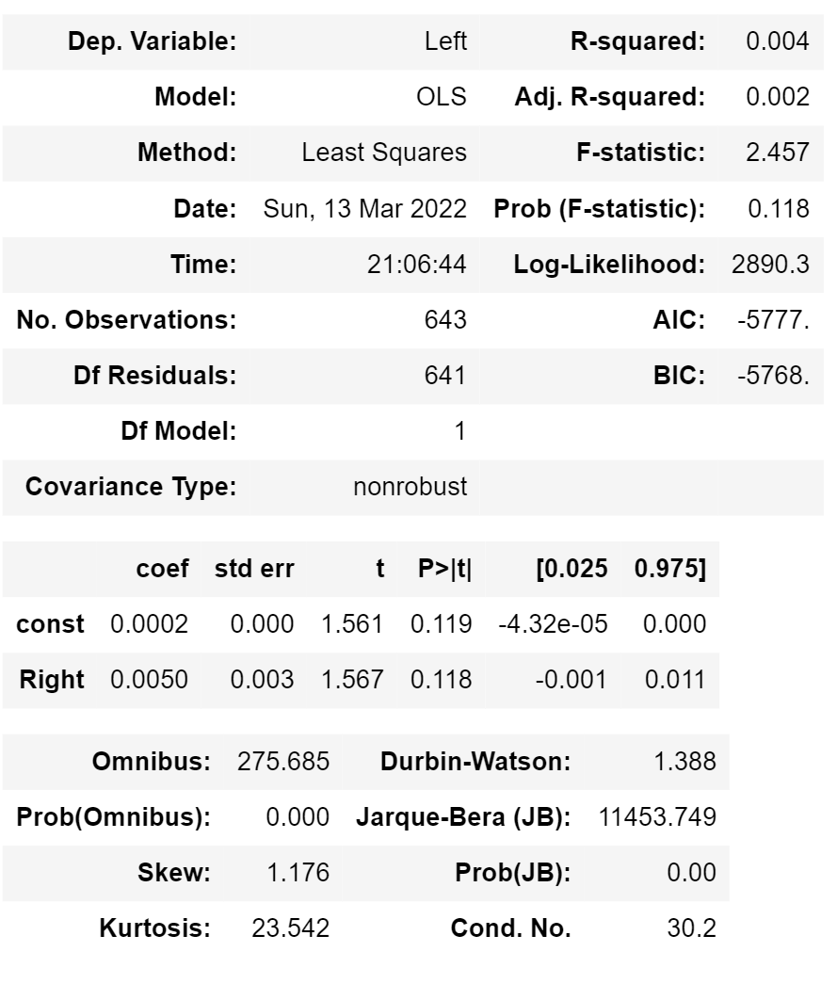
Regression analysis
4. Left side vs right side

Slide 16
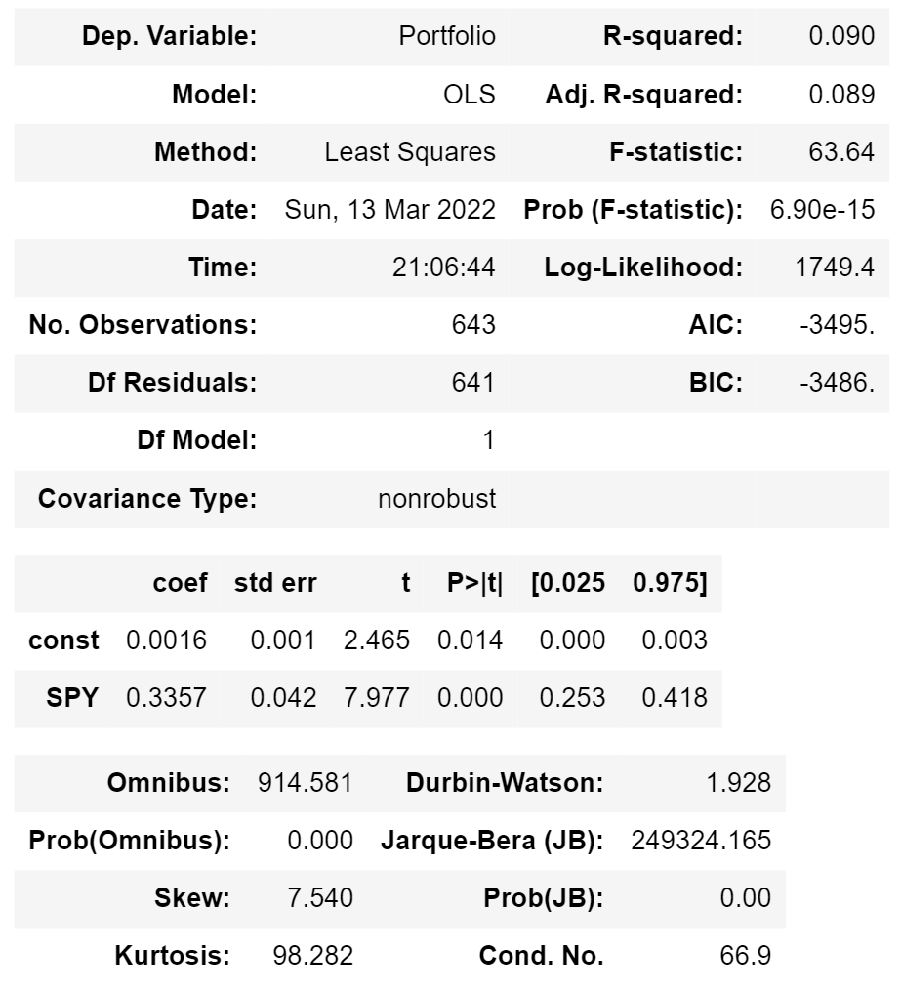
Regression analysis
5. Overall portfolio vs market

Slide 17
3. Monte Carlo simulations

Slide 18
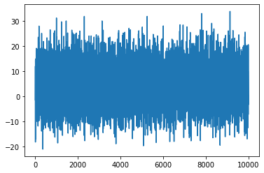
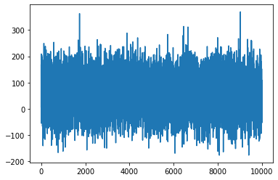
Monte Carlo simulations
Left side Right side

Slide 19
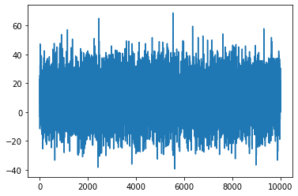
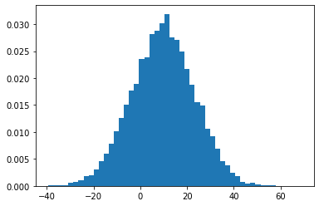
Monte Carlo simulations
Portfolio

Slide 20
4. Conclusions

Slide 21
Conclusions
Small sample size seriously affected the results of both regression analysis and Monte Carlo simulation.
Barbell portfolio is designed to be antifragile to any kind of event - especially market crushes - and it is unfortunate that my security selection limits the possibility of testing the portfolio under such extreme conditions.

Slide 22
Conclusions
Regression analysis has shown that our economic intuitions are mostly right:
the safe side returns are slightly negatively affected with the market returns,
while for the overall portfolio, having a bigger market coefficient, the market explains only 9% of the variation of returns.
It’s good because the portfolio shouldn’t be affected by market returns much.

Slide 23
Conclusions
Monte Carlo simulation, on the other hand, in spite of the fact that its usage in this case is conceptually flawed, still showed that
our economic intuition is right
and that the overall portfolio has a bigger impact from the risky side as well as a positive skewness - in other words, exposition to the extreme upside - which is one of its two important features.

Slide 24
Conclusions
Overall
Barbell portfolio is antifragile
It allows to not commit a mistake of applying the tools of normal distribution (the only ones we really have) to thick-tailed distributions.

Slide 25
Thank you!

